Slide 2

The A to Z of DX10 Performance
Cem Cebenoyan, NVIDIA
Nick Thibieroz, AMD

Slide 3
Color Coding
ATI
NVIDIA

Slide 4
API Overview
DX10 is designed for performance
  No legacy code
  No support for fixed function pipeline
Most validation moved from runtime to creation time
User mode drivers
  Less time spent in kernel transitions
Memory manager now part of OS
  Vista handles memory operations
DX10.1 update adds new features
  Requires Vista SP1

Slide 5
Benchmark Mode
Benchmark mode in game essential tool for performance profiling
  Application-side optimizations
  IHVs app and driver profiling
Ideal benchmark:
  Can be run in automated environment
    Run from command line or config file
    Prints results to log or trace file
  Deterministic workload!
    Watch out for physics, AI, etc.
  Internet access not required!
  Benchmarks can be recorded in-game

Slide 6
Constant Buffers
Incorrect CB management major cause of slow performance!
When a CB is updated its whole contents are uploaded to the GPU
  But multiple small CBs mean more API overhead!
Need a good balance between:
  Amount of data to upload
  Number of calls required to do it
Solution: use a pool of constant buffers sorted by frequency of updates

Slide 7
Constant Buffers (2)
Don’t bind too many CBs to shader stages
  No more than 5 is a good target
Sharing CBs between different shader types can be done when it makes sense
  E.g. same constants used in both VS and PS
Group constants by access pattern
float4 PS_main(PSInput in)
{
float4 diffuse = tex2D0.Sample(mipmapSampler, in.Tex0);
float ndotl = dot(in.Normal, vLightVector.xyz);
return ndotl * vLightColor * diffuse;
}
cbuffer PerFrameConstants
{
float4 vLightVector;
float4 vLightColor;
float4 vOtherStuff[32];
}; GOOD
cbuffer PerFrameConstants
{
float4 vLightVector;
float4 vOtherStuff[32];
float4 vLightColor;
};
BAD

Slide 8
Constant Buffers (3)
When porting from DX9 make sure to port your shaders too!
  By default all constants will go into a single CB
$Globals CB often cause poor performance
  Wasted cycles transferring unused constants
    Check if used with D3D10_SHADER_VARIABLE_DESC.uFlags
  Constant buffer contention
  Poor CB cache reuse due to suboptimal layout
Use conditional compiling to declare CBs when targeting multiple versions of DX
  e.g. #ifdef DX10 cbuffer{ #endif

Slide 9
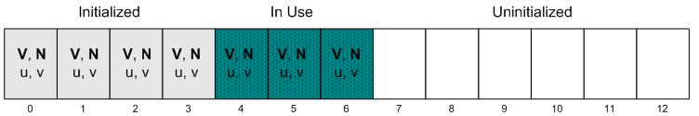
Dynamic Buffers Updates
Created with D3D10_USAGE_DYNAMIC flag
  Used on geometry that cannot be prepared on the GPU
  E.g. particles, translucent geometry etc.
Allocate as a large ring-buffer
Write new data into buffer using:
  Map(D3D10_MAP_WRITE_NOOVERWRITE,…)
    Only write to uninitialized portions of the buffer
  Map(D3D10_MAP_WRITE_DISCARD,…)
    When buffer full

Slide 10
Early Z Optimizations
Hardware early Z optimizations essential
to reduce pixel shader workload
Coarse Z culling impacted in some cases:
  Pixel shader writes to output depth register
  High-frequency data in depth buffer
  Depth buffer not Clear()ed
Fine-grain Z culling impacted in some cases:
  Pixel shader writes to output depth register
  clip()/discard() shader with Z/stencil writes
  Alpha to coverage with Z/stencil writes
  PS writes to coverage mask with Z/stencil writes
Z prepass is usually an efficient way to take advantage of early Z optimizations

Slide 11
Formats (1) Textures
Be careful of lower rate texture read formats:
  DXGI_FORMAT_R16G16B16A16_* and up
  DXGI_FORMAT_R32_*
  ATI: Unless point sampling is used
  Consider packing to avoid those formats
DX10.1 supports resource copies to BC
  From RGBA formats with the same bit depth
  Useful for real-time compression to BC in PS

Slide 12
Formats (2) Render Targets
Note slower rate render target formats:
  DXGI_FORMAT_R32G32B32A32_*
  ATI: DXGI_FORMAT_R16G16B16A16 and up int format
  ATI: Any 32-bit per channel formats
Performance cost increase for every additional RT
Blending increases output rate cost on higher bit depth formats
DX10.1’s MRT independent blend mode can be used to avoid multipass
  E.g. Deferred Shading decals
  May increase output cost depending on what formats are used

Slide 13
Geometry Shader
GS not designed for large-scale expansion
  DX11 tessellation is a better match for this
  See DX11 presentation this afternoon
“Less is better” concept works well here
  Reduce [maxvertexcount]
  Reduce size of output/input vertex structure
Move some computation from GS to VS
NVIDIA: Keep GS shaders short
ATI: Free ALUs in GS because of export rate
  Can be used to cull geometry (backface, frustum)

Slide 14
High Batch Counts
“Naïve” porting job will not result in better batch performance in DX10
Need to use API features to bring gains
Geometry Instancing!
  Most important feature to improve batch perf.
  Really powerful in DX10
  System values are here to help
    E.g. SV_InstanceID, SV_PrimitiveID
Instance data:
  ATI: Ideally should come from additional streams (up to 32 with DX10.1)
  NVIDIA: Ideally should come from CB indexing

Slide 15
Input Assembly
Remember to optimize geometry!
  Non-optimized geometry can cause BW issues
Optimize IB locality first, then VB access
  D3DXOptimize[Faces][Vertices]()
Input packing/compression is your friend
  E.g. 2 pairs of texcoords into one float4
  E.g. 2D normals, binormal calculation, etc.
Depth-only rendering
  Only use the minimum input streams!
    Typically one position and one texcoord
  This improves re-use in pre-VS cache

Slide 16
Juggling with States
DX10 uses immutable state objects
  Input Layout Object
  Rasterizer Object
  DepthStencil Object
  Sampler Object
  Blend Object
Always create states at load time
Do not duplicate state objects:
  More state switches
  More memory used
Implement “dirty states” mechanism
Sort draw calls by states

Slide 17
Klears (C was already taken)
Always clear Z buffer to allow Z culling opt.
    Stencil clears are additional cost over depth so only clear if required
Color Clear() is not free
  Only Clear() color RTs when actually required
Prefer Clear() to fullscreen quad clears
ATI: MSAA RTs always need clearing

Slide 18
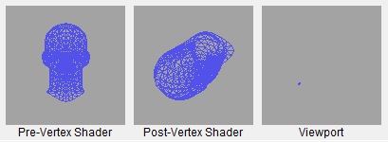
Level of Detail
Lack of LOD causes poor quad occupancy
  This happens more often than you think!
  Check wireframe with PIX/other tools
Remember to use MIPMapping
  Especially for volume textures!
  Those are quick to trash the TEX cache
GenerateMips() can improve performance on RT textures
  E.g. reflection maps
!

Slide 19
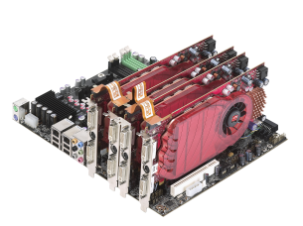
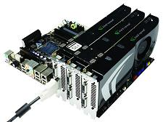
Multi GPU
Multi-GPU configuration are common
  Especially single-card solutions
    GeForce 9800X2, Radeon 4870X2, etc.
  This is not a niche market!
Must systematically test on MGPU systems before release
Golden rule of efficient MGPU performance: avoid inter-frame dependencies
  This means no reading of a resource that was last written to in the previous frame
  If dependencies must exist then ensure those resources are unique to each GPU
Talk to your IHV for more complex cases

Slide 20
No Way Jose
Things you really shouldn’t do!
Members of the “render the skybox first” club
  Less and less members in this club – good!
  Still a few resisting arrest
Lack of or inefficient frustum culling
  This results in transformed models not contributing at all to the viewport
  Waste of Vertex Shading processing
Passing constant values as VS outputs
  Should be stored in Constant Buffers instead
  Interpolators can cost performance!

Slide 21
Output Streaming
Stream output allows the writing of GS output to a video memory buffer
  Useful for multi-pass when VS/GS are complex
  Store transformed data and re-circulate it
  E.g. complex skinning, multi-pass displacement mapped triangles, non-NULL GS etc.
GS not required if just processing vertices
  Use ConstructGSWithSO() on VS in FX file
Rasterization can be used at the same time
Try to minimize output structure size
  Similar recommendations as GS

Slide 22
Parallelism
Good parallelism between CPU and GPU essential to best performance
Direct access to DEFAULT resources
  This will stall the CPU
  If required, use CopyResource() to STAGING
  Then Map() STAGING resource with D3D10_MAP_FLAG_DO_NOT_WAIT flag and only retrieve contents when available
Use PIX to check CPU/GPU overlap

Slide 23
Queries
Occlusion queries used for some effects
  Light halos
  Occlusion culling
  Conditional rendering
  2D collision detection
Ideally only retrieve results when available
  Or at least after a set number of frames
  Especially important for MGPU!
  Otherwise stalling will occur
GetData() returns S_FALSE if no results yet
Occlusion culling: make bounding boxes larger to account for delayed results

Slide 24

Resolving MSAA Buffers
Resolve operations are not free
Need good planning of post-process chain in order to reduce MSAA resolves
  If no depth buffer is required then apply post-process effects on resolved buffer
Do not create the back buffer with MSAA
  All rendering occurs on external MSAA RTs
MSAA Render Target
Non-MSAA
Back
Buffer
Resolve
Operation

Slide 25
Shadow Mapping
Shadow mapping DST formats
  ATI: DXGI_FORMAT_D16_UNORM
  NVIDIA: DXGI_FORMAT_D24_UNORM_S8_UINT
  DXGI_FORMAT_D32_FLOAT (NVIDIA: lower Zcull eff.)
Remember to disable color writes
  Depth-only rendering is much faster
Shadow map filtering
  High number of taps can be a bottleneck
  Probably don’t need aniso
  Optimizations:
    DX10.1’s Gather()
    Dynamic branching

Slide 26
Transparency
Alpha test deprecated in DX10
  Use discard() or clip() in PS
This requires two versions of your shaders!
  One with clip()/discard() for transparency
  One without clip()/discard() for opacity
Resist the urge of using a single shader with clip()/discard() for all object types
  This will impact early Z optimizations!
Put clip()/discard() as early as possible in pixel shaders
  Compiler may be able to skip remaining code

Slide 27
Updating Textures
Avoid creating/destroying textures at run-time
  Significant overhead in these operations!
  Will often lead to stuttering
Create all resources up-front if possible
  Level load, cut-scenes or other non-performance critical situations
Perform updates by replacing contents of existing textures
  Can be a problem if textures vary a lot in size
  Texture atlases are a good way to avoid this

Slide 28
Updating Textures (2)
Avoid UpdateSubresource() path for updating textures
  Slow path in DX10
  Especially bad with large textures
Use ring buffer of intermediate D3D10_USAGE_STAGING textures
  Call Map(D3D10_MAP_WRITE,…) with D3D10_MAP_FLAG_DO_NOT_WAIT to avoid stalls
  If Map fails in all buffers: either stall waiting for Map or allocate another resource (cache warmup)
  Copy to textures in video memory
    CopyResource() or CopySubresourceRegion()

Slide 29
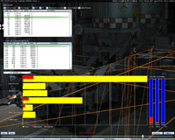
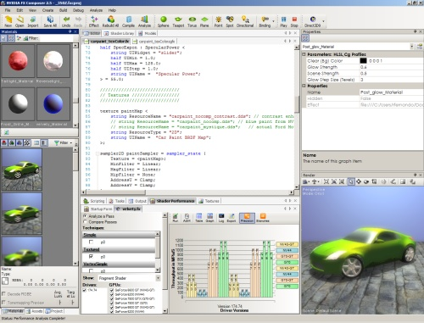
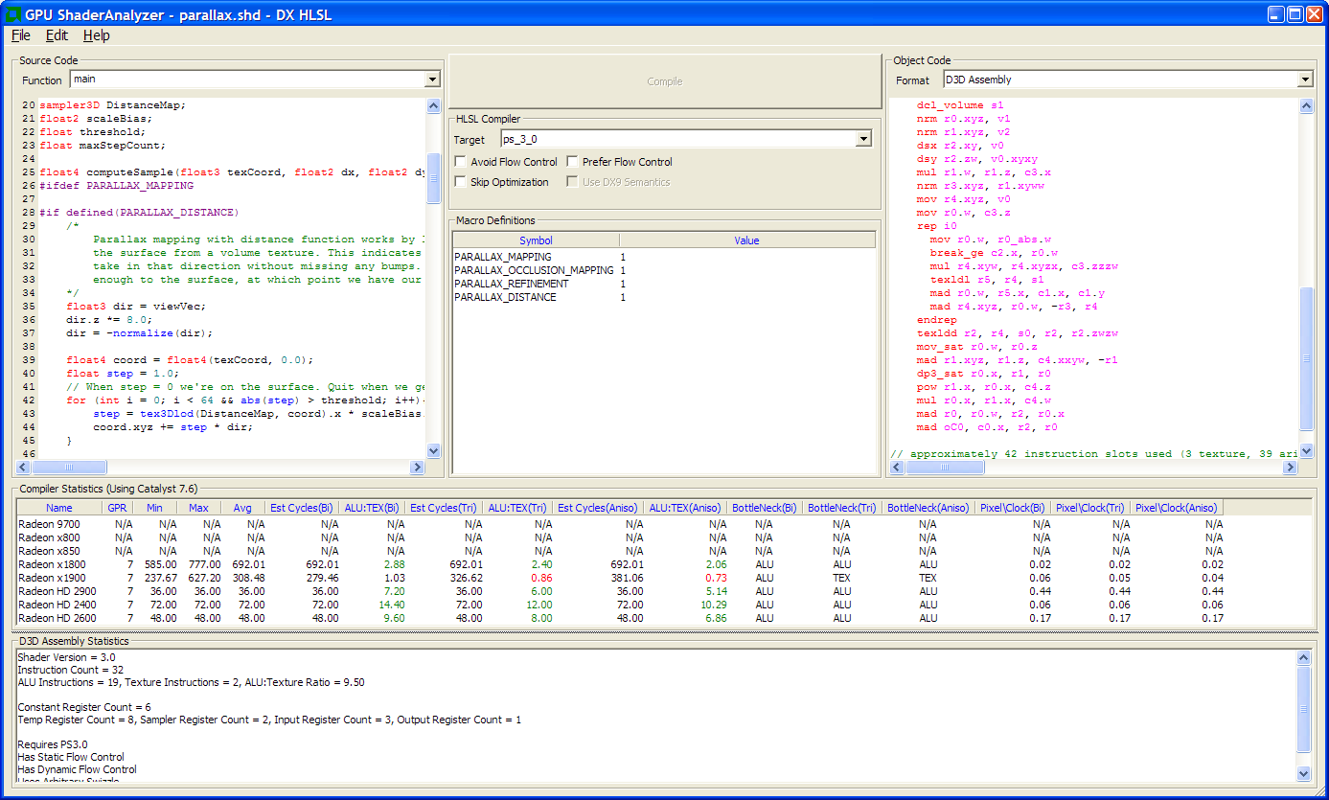

Verifying Performance
Remember to use IHV tools to help with performance analysis!
NVPerfHUD / FXComposer / ShaderPerf
GPUPerfStudio / GPUShaderAnalyzer

Slide 30
Writing Fast Shaders
Shader code has a direct impact on perf.
  Writing quality code is essential
Be aware of ALU:TEX HW ratios
  ATI: 4 5D ALU per TEX on ATI HW
  NVIDIA: 12 scalar ALUs per TEX on NV HW
Can also be interpolators-limited!
  Reduce total number of floats interpolated
  ATI: Use packing to reduce PS inputs
Write parallel code to maximize efficiency
Check for excessive register usage
  NVIDIA: >10 GPRs is high on GeForce
Use dynamic branching to skip instructions
  Make sure branching has high coherency though

Slide 31
Writing Fast Shaders (2)
Not all ALU instructions are equal
  Integer multiplication and division
  Type conversion (float to int, int to float)
  Check with your IHV for list of slower instructions
Same goes for TEX instructions
  Sample>>SampleLevel>>SampleGrad
  Texture type and filter mode impacts cost too!
    E.g. Volume textures, 128 bits formats, aniso
Temp registers indexing likely to be slow
  Dynamic CB indexing in PS can be costly too
Too many static branches may limit the scope for optimizations
  Implement conditional compilation from the app

Slide 32


Xtra Performance
Fullscreen Quad vs Fullscreen Triangle
  Triangle = maximal quad occupancy!
No BC2/BC3 for fully opaque textures!
Efficient triangulation
  Max area is best
Credit: Emil Persson

Slide 33

Z-Buffer Access
Accessing the depth buffer as a texture
Useful for a number of effects requiring Z
  No need to write Z separately in RT or extra pass
DX10.1 vs DX10.0 differences
  DX10.0: SRV only allowed for single-sample DB
  DX10.1: SRV allowed for multi-sampled DB too
Accessing multisampled DB:
  No need to fetch all samples and average them
  Just use the first sample and output to RT
    No visual issue will ensue on low-freq operations
    E.g. DOF, SSAO, soft particles, etc.
  Can also be done to produce a single-sample DB
    Disable color writes and writes 1st sample to oDepth

Slide 34
Your Call To Action
Proper managing of resources is key to good DX10/DX10.1 performance
  Constant Buffers
  Texture/Buffers updates
Geometry instancing to improve batch performance
Shader balancing
  Use the right tools for the job
Keep multi-GPU in mind when testing and developing

Slide 35
Questions?
devrel@amd.com

